Slide 1
Tobacco Harm Reduction with snus, nicotine pouches
The Swedish Experience
Prof. Lars E. Rutqvist, M.D., Ph. D., Riga, Sep 2023

Slide 2
CV: Lars E. Rutqvist
1976 M.D., Karolinska Institutet Medical School
1979 - 2005 Department of Oncology, Karolinska University Hospital
2006 - 2017 Scientific Affairs Group, Swedish Match AB
2017 - Independent consultant

Slide 3
Population-based, case-control study of risk factors for head-neck (incl. oral) cancer
Background
Smoking & alcohol major risk factors
What about other exposures?
Diet
Work-related exposures
Swedish snus

Slide 4
Main findings, relative risks:
Cigarette smoking 6-7
Alcohol 5
Smoking & alcohol 10-15
Vitamin C 0.8
Welding fumes 1.2
Snus 1.0 (95% CI: 0.8-1.2)
Lewin F, Norell SE, Johansson H, Gustavsson P, Wennerber J, Biörklund A, Rutqvist LE: Smoking tobacco, oral snuff, and alcohol in the etiologu of squamous cell carcinoma of the head and neck: a population-based case-referent study in Sweden. : Cancer 1998

Slide 5
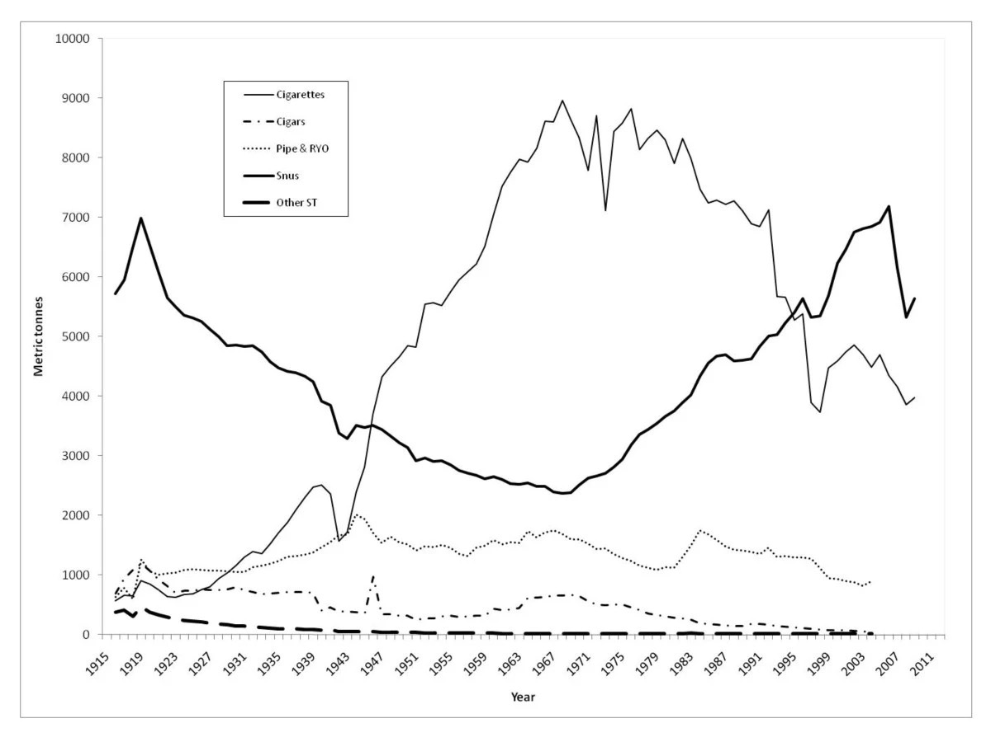
Tobacco sales in Sweden in the 20th century according to product category
Cigarettes
Snus
Ref: Rutqvist et al, 2011

Slide 6
Why did Swedish smokers start to switch to snus in the early 1970s ?

Slide 7
Drivers of the switch to snus?
Reports of cancer risks associated with cigarette smoking (Royal College of Physicians, Surgeon General, etc)
Snus deeply rooted in Swedish culture, generally viewed as being more “natural”, not associated with “Big Tobacco”
Student revolution, "Green movement" in the late 60s, 70s
Pouched products (1972)
Snus cheaper than cigaretters due to different excise taxes
Can be used discreetly, not affecting others, unaffected by smoking bans, no 2nd hand smoke
Switch to snus was a "grass roots movement" among cigarette smokers, unrelated to either marketing by industry or regulatory actions by health authorities

Slide 8
What about government actions, regulations, European Union ?
Swedish government, government agencies did not advocate snus as a smoking cessation aid (although in recent years accepting the vast risk differential between snus and cigarettes)
European Union: late 1990s TPD mandated a health warning on snus cans: “Causes cancer”. This warning was dropped in 2001 (as it was contradicted by scientific studies), replaced by the generic warning (“May damage your health”), still no explicit acceptance of THR
During the past 10 years Swedish politicians have become more aware of the available science about snus and its health effects, general acceptance of the fact that snus is dramatically less risky than cigarettes, increased awareness of the concept of Tobacco Harm Reduction
Science-based regulation of both snus & nicotine pouches (still no rebgvulation of nicotine)
The current Swedish government coalition proposes a lowered excise tax on snus & nicotine pouches for 2024 (sic!)

Slide 9
EUROBAROMETER, 2021
Prevalence of daily tobacco use – cigarettes, e-cigarettes, heated tobacco products, water pipes oral, chewing or nasal tobacco – EU27+ UK + Norway (%)
Base: All respondents

Slide 10
EUROBAROMETER, 2021
Current tobacco smokers – EU27 + UK + Norway + Switzerland (%)
Base: All respondents
Notes:
Current smokers definieras som människor vilka för nuvarande röker cigaretter, cigarrer, pipa eller cigariller.
Sverige har fortsatt lägst andel rökare i Europa 7%. Siffran är oförändrad jämfört med förra mätningen som genomfördes 2017. Värt att notera dock är att andelen rökare har minskat med 11 procentenheter sedan 2006. England och Holland följer med 12 procent. Högst andel rökare finns i Grekland (42%), Bulgarien (38%) och Ungern (36%). Finland och Danmark ligger precis som Sverige under genomsnittet (23%) på 15% respektive 16%.

Slide 11
EUROBAROMETER, 2021
Average number of cigarettes smoked daily – EU27 + UK
Base: Respondents who smoke cigarettes
Notes:
Rökare i EU röker i snitt 14,2 cigaretter per dag i EU. Värst är grekerna med 18,7 cigaretter per dag och bäst är Sverige med 9,1 cigaretter per dag.

Slide 12
Ex-smokers eu28 – men & women
EUROBAROMETER, 2021
Used or tried oral tobacco (snus), chewing or nasal tobacco – EU27 + UK (%)
Base: All respondents

Slide 13
WHO data on ratio of death rates* attributable to tobacco among males: Sweden vs other EU countries
Age (years) | All causes | Lung cancer | All CV
45-59 | 0.15** | 0.24 | 0.13
60-69 | 0.27 | 0.38 | 0.19
70-79 | 0.42 | 0.49 | 0.33
* A ratio <1.0 indicates a
lower death rate.
** The ratio shows that Swedish
males only have 15% of the death
ratein other EU countries
Ref: Ramström L, Wikmans T, Tobacco Induced Diseases, 2014

Slide 14
Adverse health effects of conventional cigarettes
Mechanisms, outcomes
Cigarette smoke contains combustion products, some of which are highly carcinogenic
Inhalation of cigarette smoke leads to a chronic irritation in the respiratory tract
Unknown components in cigarette smoke contributes to a systemic, chronic inflammatory state in some habitual smokers (as evidenced by increases in blood markers such as fibrinogen & CRP)
Excess mortality among cigarette smokers:
1/3 due to 12-15 types of cancer (70% lung cancer)
1/3 due to cardiovascular disease (myocardial infarction, stroke)
1/3 due to COPD (e. g. chronic bronchitis, emphysema
It’s not the nicotine that makes cigarette smoking a major health concern!

Slide 15
Swedish, epidemiological studies on long-term health outcomes among snus users published since the 1990s
200-300 publications
>100,000 snus users
Studies done by independent, university-based research groups
Findings:
No increased risk of oral cancer
No increased risk of lung cancer
No increased risk of any other type of cancer
No increased risk of cardiovascular disease (myocardial infarction, stroke)

Slide 16
All tobacco products are not the same, some smokeless products (like Swedish snus, nicotine pouches) are clearly much less dangerous to health than conventional cigarettes
In 2019 FDA issued their first and hitherto only "modified risk order"for Swedish snus. The order authorises marketing of snus using health claims. The order was based on a review of all the scientific evidence about snus which shows reduced (or rather no) major health risks among users as well as a potential for public health benefit

Slide 17
“Using General snus instead of cigarettes puts you at a lower risk of mouth cancer, heart disease, lung cancer, stroke, emphysema, and chronic bronchitis”
FDA, Center for Tobacco, Oct 22, 2019

Slide 18
But what about nicotine?
Nicotine is a mild stimulant (like caffeine) that is unassociated with all of the major, smoking-related diseases
Not completely safe for all users:
Adverse pregnancy outcomes among cigarettes smokers as well as snus users
No adverse effects among those who stop using nicotine after the 1st trimester
Potential adverse effect on the prognosis among patients diagnosed with cardiovascular disease ??

Slide 19
Nicotine
Problems, potential
Addiction
Adverse health effects in subsets of users?
Positive effects on mood & cognition (like caffeine)
Preventive effect in some neurological diseases (Parkinson's disease, Alzheimer's disease?)

Slide 20
Nicotine pouches: "Snus 2.0”, the most promising future product for THR
No tobacco
No combustion/heating, no inhalation, no 2nd hand vapor/smoke
“Controversial substances” (like carcinogenic nitrosamines) not an issue
Similarities in usage & nicotine exposure permits using “snus epidemiology” as a proxy for potential adverse health effects (“worst case scenario”)
Functional advantages (no staining of teeth, halitosis, gum problems)
Attractive also to new groups of smokers e g females
Comparable nicotine delivery suggests comparable efficacy to help smokers quit cigarettes
Consumer surveys in the US indicate that nicotine pouches are not attractive to current non-users of tobacco products

Slide 21
“THR with snus, nicotine pouches are solely developed, marketed by “Big Tobacco” to maintain and promote nicotine addiction..."
THR with a non-combustible, low-risk tobacco product (nasal snuff) was first proposed by British tobacco researchers already in the 1970s
THR prominent topic among the tobacco research community for more than 10-15 years
Since 2017 the U.S. FDA explicitly aims to phase out conventional cigarettes with the help of novel, low-risk, nicotine delivery products
THR with low-risk products (e-cigarettes) is promoted by Public Health England

Slide 22
Conclusions
"Swedish Experience" clearly shows that THR with a low-risk, nicotine-delivery products, as an alternative to conventional cigarettes is a valid concept with potential positive public health effects
"One size does not fit all”
Pharmaceutical nicotine delivery products
Snus
Nicotine pouches
E-cigarettes
"Heat not burn" products
Need for science-based regulation of novel products (not arbitrary rules that act as “prohibition by stealth”)
Major factors working against THR
Ideology (instead of pragmatism)
Lack of knowledge about the scientific platform for THR
“Opinion-based” regulation rather than pragmatic regulation rooted in science

